Slide 1

Team Name: Edubuk
Track: Education Use Case
Use Case: Immutable & Verifiable Digital Record of Learning and Experience
Founders:
Shivani Mehrotra Bajaj
Academic Profile: MBE, UGC NET in Management & Economics, University Topper
Professional Profile: Assistant Professor in NAAC Grade “A” College(s)
Apoorva Bajaj
Academic Profile: B.Tech (IIT), MBA (IIM), Gold Medalist & CFA (US)
Professional Profile: Investment Management Analyst, Goldman Sachs, J.P. Morgan
Technical Team Members:
Mandala Akshay Kumar Goud
Full Stack Developer, Edubuk
Microsoft Student Partner
Sandeep Kiran Dondapati
Cloud Consultant
Senior Software Developer

Slide 2








Problem in the Education System
“If You Judge A Fish By Its Ability to Climb a Tree, It will Live Its Whole Life Believing That it is Stupid!”—Albert Einstein
Despite the fact that different student have:
Different Brains; Strength; Passion; Talent; Dreams & Calibre
Our Current Education System Makes each student:
Go through the exact same syllabus & curriculum, make them appear for the exact same tests to compete for a Letter Grade A!
Source: Times of India, 31st March 2018
Source: Economic Times, 9th April 2018
Source: Times of India, 6th March 2018
Source: Times of India, 3rd April 2018
Source: www.thewire.in/macro, 24th April 2018
Source: Youthkiawaaz, 15th March 2018
Source: www.zeenews.india.com, 18th April 2018
Source: Times of India, 4th June, 2018

Slide 3





Proposed Solution
Vision: Create an Individualized Learning & Earning model along with building Transparency & Trust in the Education System with the application of Deep Technologies (M.L. & Blockchain)
Step 1: Know-The-Learner (KTL)
M.I.I.T. * Screening
Intelligence Type Interests & Talent
Personalized Career Mapping
Career Path Chosen
Learner
* M.I.I.T. : Multiple Intelligence, Interests & Talent
Learner Profiling
Step 2: Customized-Learning-Plan (CLP)
Learning
A.I. & M.L. Tech. Based Tool
Customized Learning Plan
Online
Learner Profile
Learning
Skilled Professional
Offline
Step 3: Create-Your-Edubuk (CYE)
Customized Learning Plan
Learner’s Profile
Credits & Grades
EDUBUK (Professional Profile
Verifiable on the Blockchain)
Subjects, Courses & Projects
Educational Certificates &, Transcripts
Work Experience Certificates

Slide 4
Tech Architecture
HYPERLEDGER FABRIC
Organization 1: Educational Certificate Issuing Authority (ECIA)
Client
SDK
Certificates, Transcripts, etc..
Transaction Proposal
(Eg. Student)
(Node JS)
Endorsing Peer 1
Endorsing Peer 2
CA
University/Board
College/School
CA
Invocation
Request
Examination Branch
Examination/Admin Dept
CouchDB
Chain Code
CouchDB
Chain Code
Ordering Service Node (OSN)
Endorsement Response with Signature
Orderer
Consensus Achieved
Committing to Blockchain
Invocation
Organization 2: Employer(s)
Client
SDK
Work-Experience Letter
Transaction Proposal
(Eg. Employee)
(Node JS)
Endorsing Peer 1
Endorsing Peer 2
CA
Business Head/ Manager
Human Resources Department
CA
Invocation
Request
CouchDB
Chain Code
CouchDB
Chain Code
Ordering Service Node (OSN)
Endorsement Response with Signature
Orderer
Consensus Achieved
Committing to Blockchain
Invocation

Slide 5
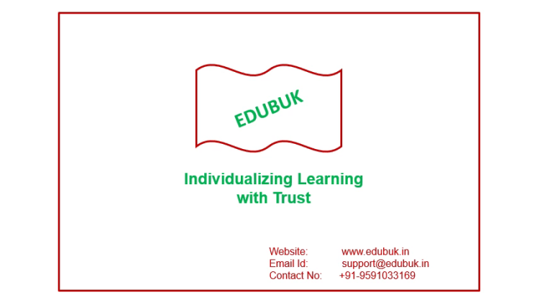
Product Demo
Please Click on the Video Above for a Product Demo!

Slide 6
Summary
Business Model (Revenue Streams):
Competitive Advantage (USP):
Focus on “Individualized Learning” in–sync with Learner’s Intelligence Type, Interests & Passion with the use of “Customized Learning Plan” to help in acquiring “Only Relevant Skills” using “Online-Cum-Offline” Learning Medium Options & make him “Job-Ready”.
First of its kind “Centralized, Verifiable and Trustworthy” Platform which also provides “Learning Anytime Anywhere” Opportunities with the relevant use of A.I. M.L. & Blockchain Technology.
Focus on Less Explored Unconventional Career Paths like being a dancer, musician, singer, artist, sportsperson, actor etc.
Milestones Achieved:
Data Sampling in 10 Schools
Inception & Ideation
Top 3000 in Smart Fifty
Top 7 in Catapooolt 2018
Team of 28 Interns
Sept. 2017
Jan. 2018
April 2018
May 2018
July 2018
Dec. 2017
April 2018
April 2018
June 2018
Test Development (M.I.I.T. Screening)
Top 10 in SRiX 1.0
Session on Future of Education for 45 Participants
Top 2 in Startup Grill, CloWork, Hyderabad

Slide 7
If we can have Customized LinkedIn Profiles, Customized Facebook Pages, why cannot we create a Customized Learning Profile i.e. EDUBUK
Thank You

